Slide 1
Executive Summary
Problem
A local retailer wants to determine the impact of implementing sustainability messaging on cleaning product labels.
Analysis
Measured distribution of positive and negative survey responses about consumer perceptions and behaviors towards sustainability messaging.
Tested correlations between key variables.
Tested relationships between key variables.
Results
Survey responses were closely balanced between positive and negative sentiment.
Recommendations
No strong correlations were found between key variables.
No strong relationships were found between key variables.
Capture feedback targeted to specific consumer groups.
Run a pilot study to measure impact of targeted marketing.

Slide 2
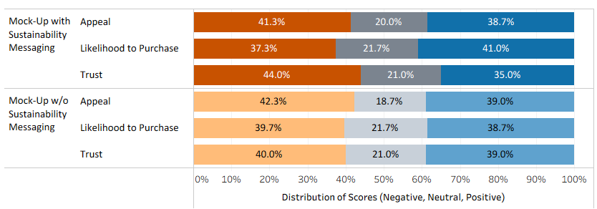
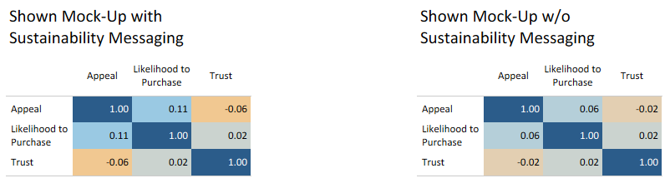
Behavioral Study Findings
Sentiment toward sustainability messaging is mixed. Participants were not more likely to purchase the product when a sustainability message was shown.
Correlation analysis shows no strong relationships. The presence or absence of sustainability messaging did not significantly affect key variables such as appeal, likelihood to purchase, or trust.
Note: Similar results were found in the perception study.

Slide 3

Key Insights and Recommendations
Key Insights
Broad sustainability messaging has limited market impact.
Five consumer groups differ in sustainability attitudes and behaviors.
Cost sensitivity and lack of choice are consistent barriers across all groups.
Recommendations
Confirm whether industry trends align with our customer base.
Identify which messages resonate most with high-impact segments.
Define the most effective sustainability positioning for cleaning products.
Pilot targeted messaging to test profit potential.
Measures
Establish a baseline using the prior year’s $70K sales gap.
Set quarterly KPIs — e.g., reduce the sales gap by 2.5% per quarter in Year 1.

